Slide 1
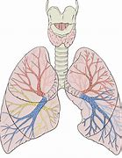
Respiratory System
AEHBY ATAR Human Biology

Slide 2
Review
What is the hierarchy of body organisation?
What types of tissues would you expect to find in the respiratory system?
What requirements do cells have that relies on the respiratory system?
Which means of cell transport are used for oxygen, carbon dioxide and water? Explain why this mechanism suits the molecular structure of these substances.

Slide 3
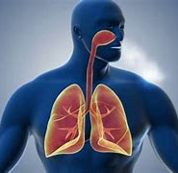
Learning Intentions
the exchange of gases between the internal and external environments of the body is facilitated by the structure and function of the respiratory system at the cell, tissue and organ levels

Slide 4
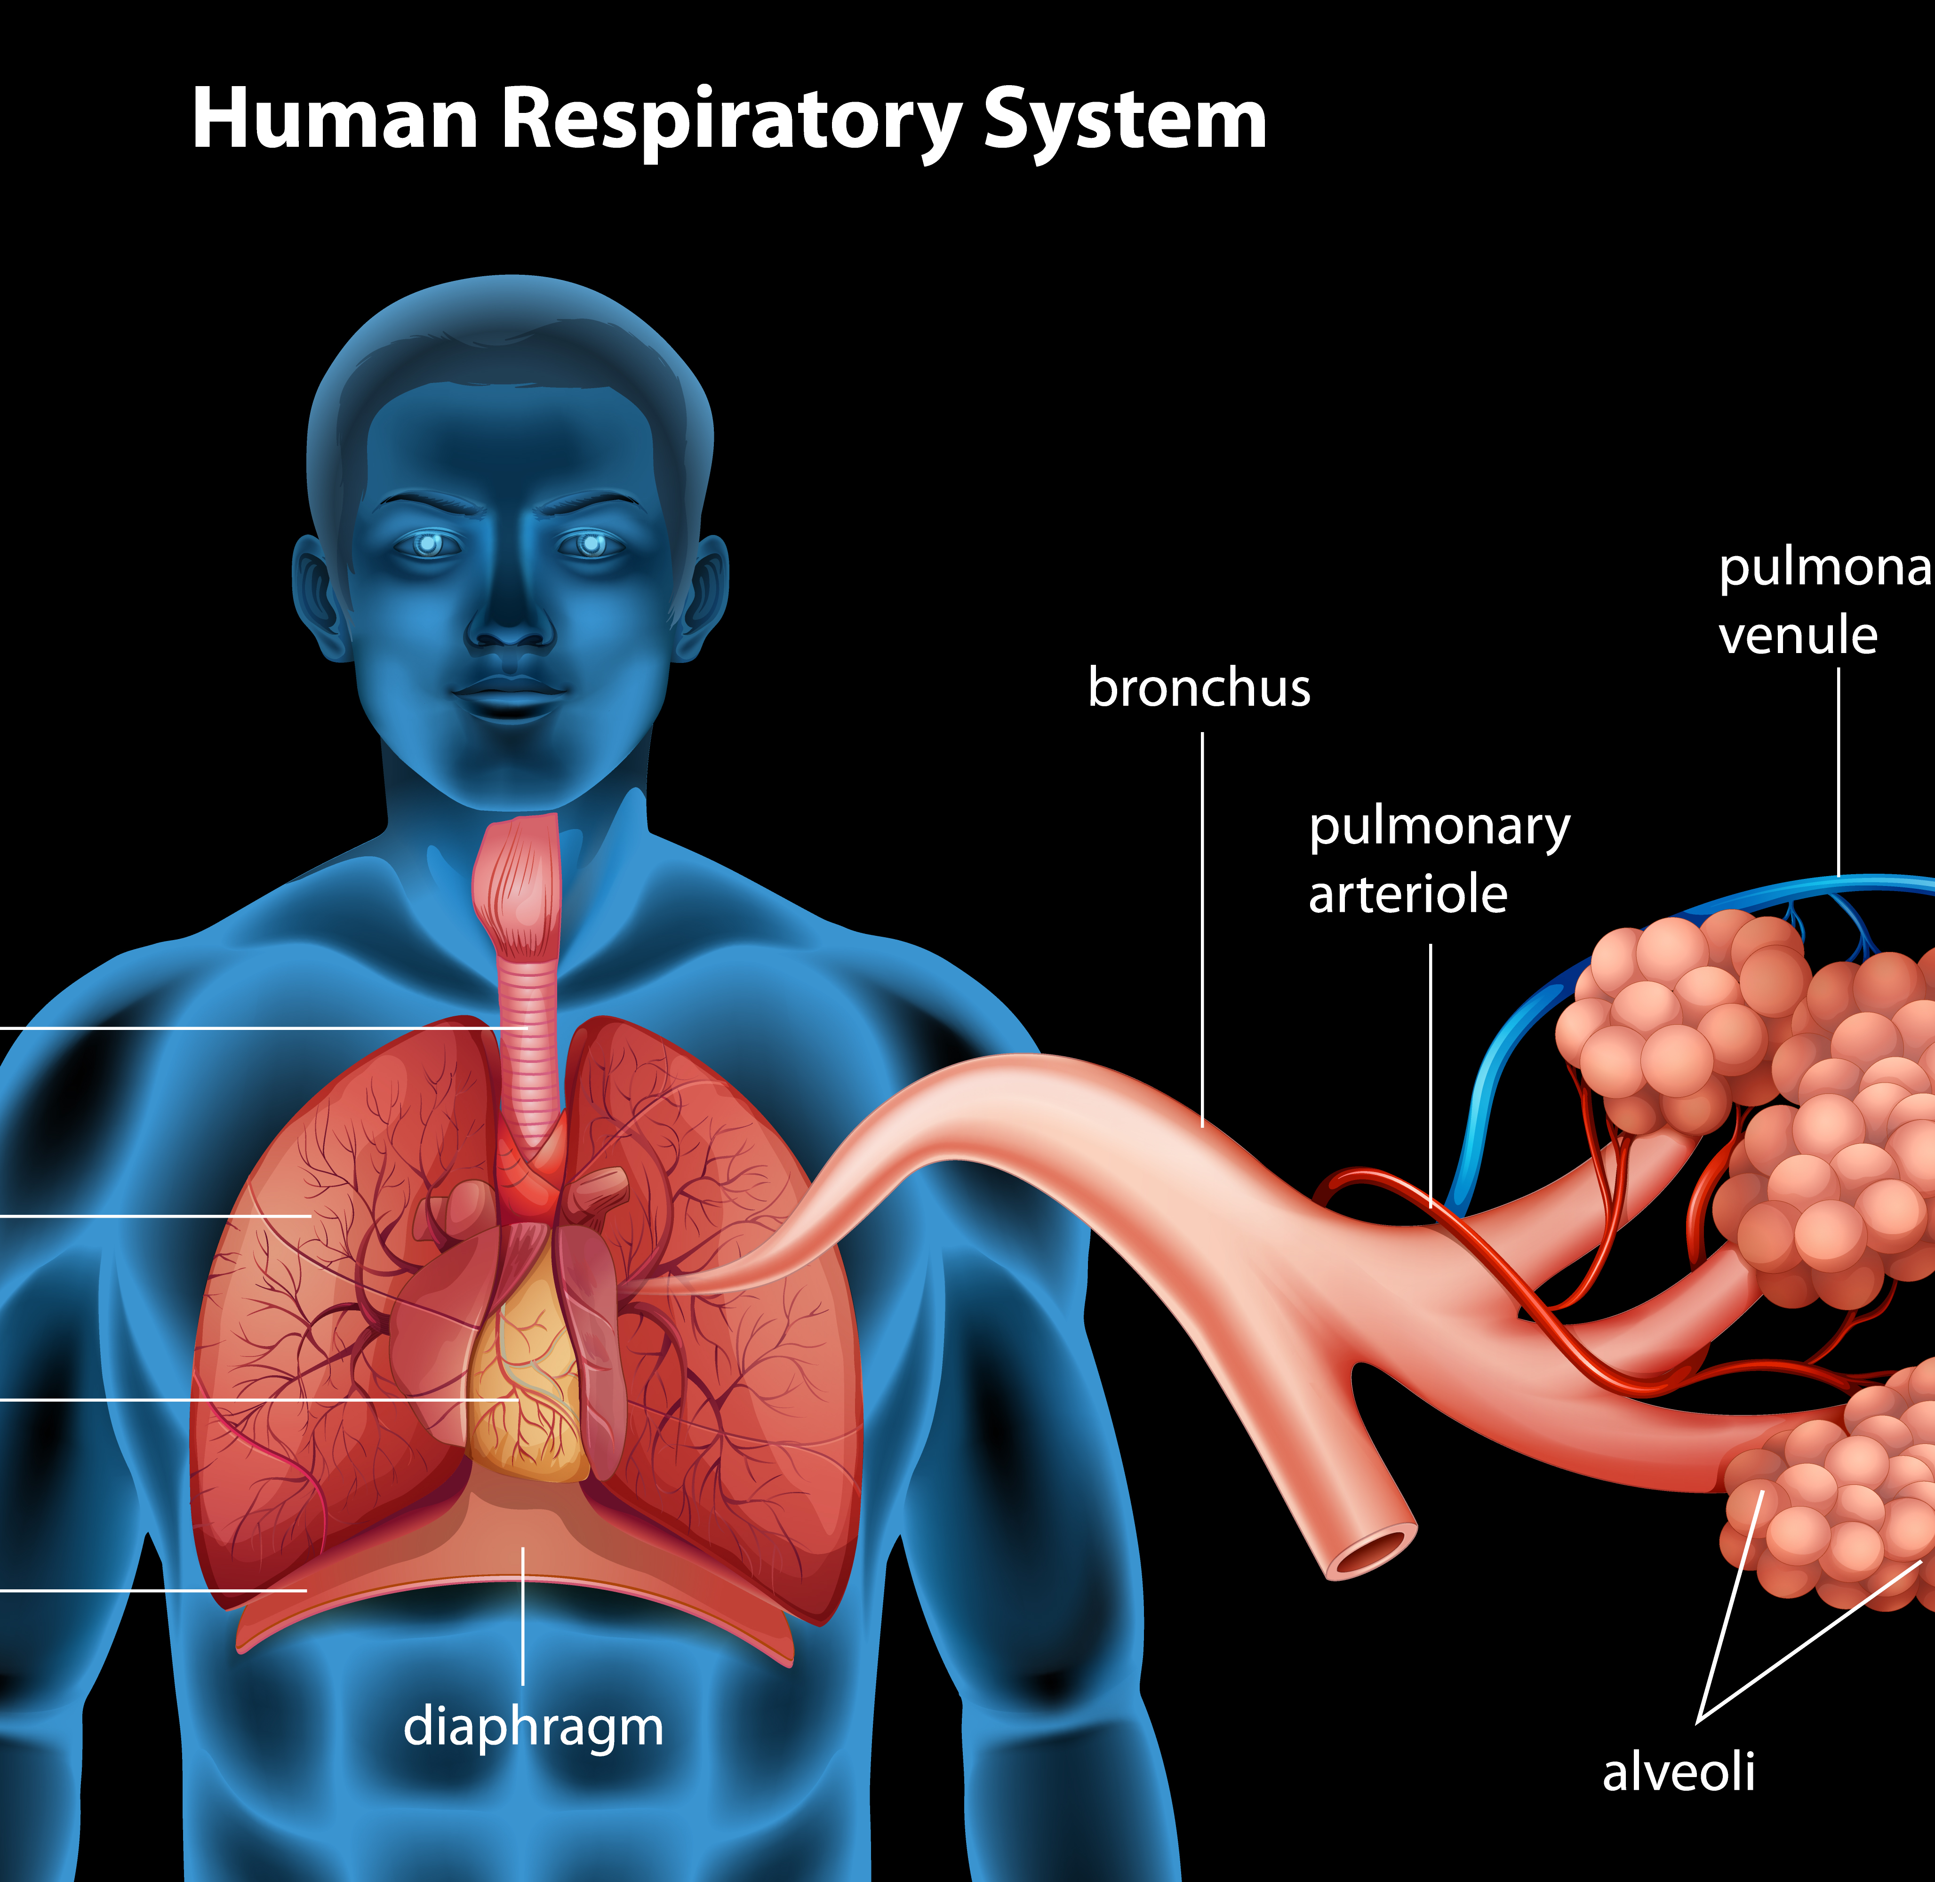
Success Criteria
Label an anatomical diagram for the respiratory system
Describe the function of each part
Relate the structure to the function at the macroscopic and microscopic level

Slide 5
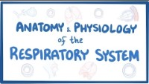

Slide 6
The respiratory system
All cells in the body need oxygen for cellular respiration and a mechanism for removal of carbon dioxide.

Slide 7
The respiratory system
For the efficient exchange of gases between the blood and air in the alveoli, air must continually be refreshed or moved into (inspiration) and out of the lungs (expiration) by breathing (ventilation).

Slide 8
The respiratory system
Air flows from places of high pressure to places of low pressure, which is achieved by moving the diaphragm and intercostal muscles to change the volume of the chest cavity.

Slide 9
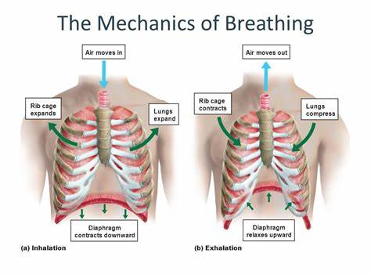

Slide 10
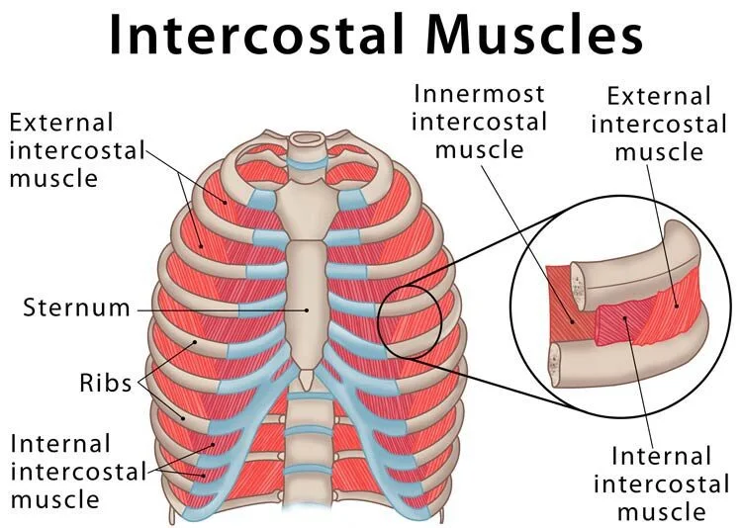

Slide 11
Success Criteria
Label an anatomical diagram for the respiratory system
Describe the function of each part
Relate the structure to the function at the macroscopic and microscopic level

